Slide 1
DSAI HW3
Q56061040 湯立婷

Slide 2
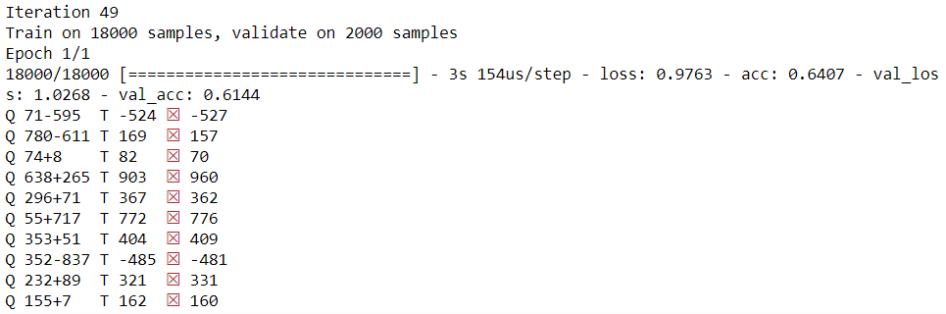
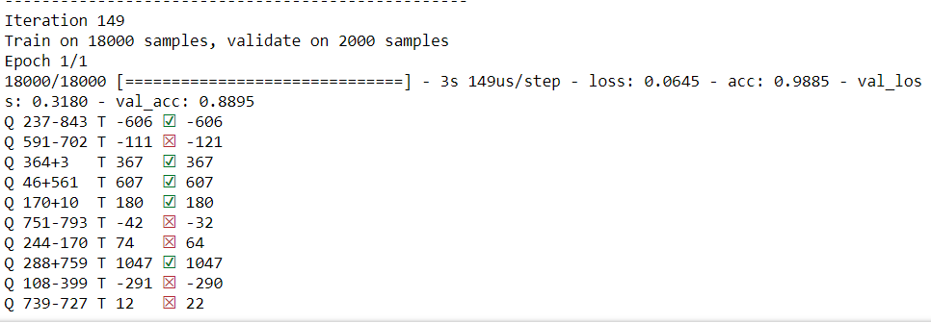
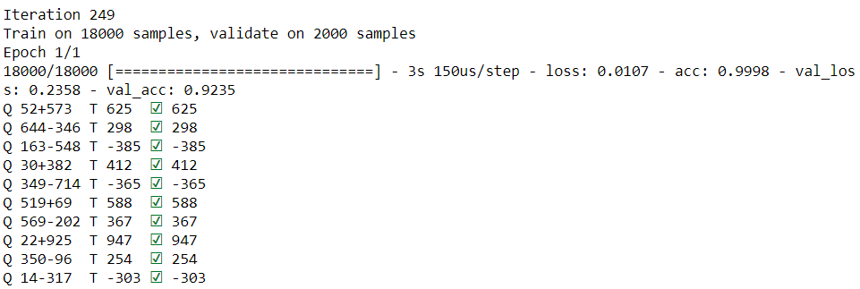
Training Epoch
Number 50:
Accuracy 低
Number150:
Accuracy 中
Number250:
Accuracy 高

Slide 3
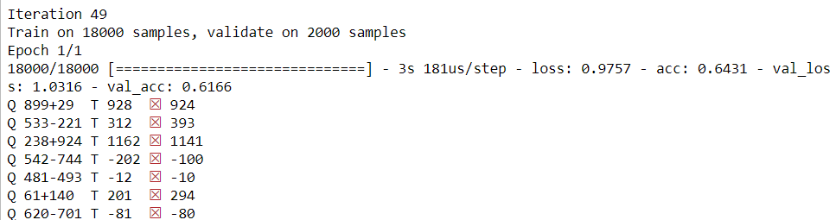
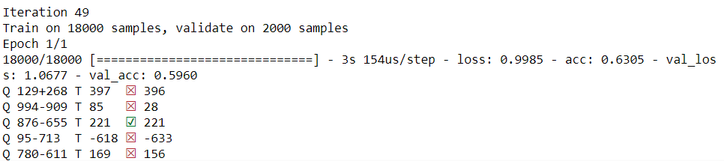
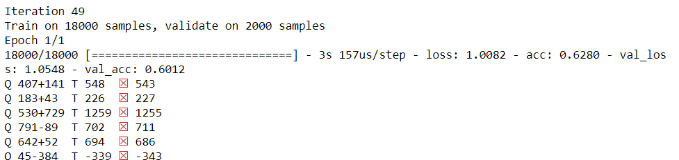
Training Size
Epoch50
Number10
Epoch50
Number100
Epoch50
Number200

Slide 4
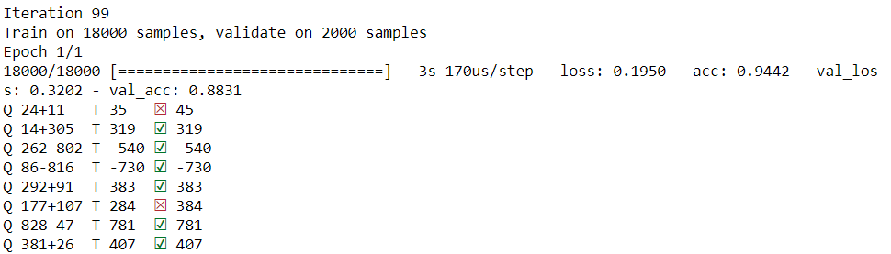
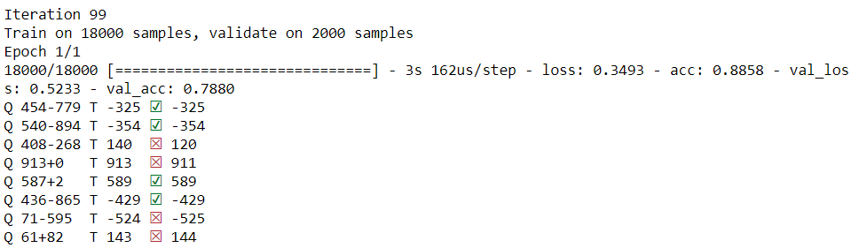
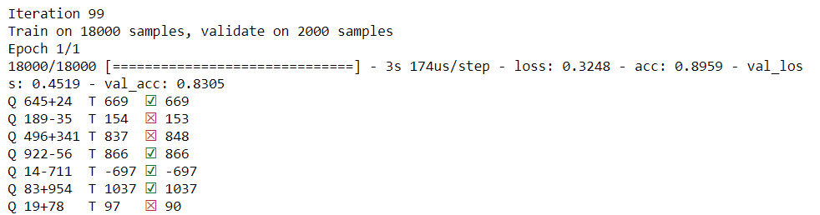
Training Size
Epoch100
Number10
Epoch100
Number100
Epoch100
Number200

Slide 5
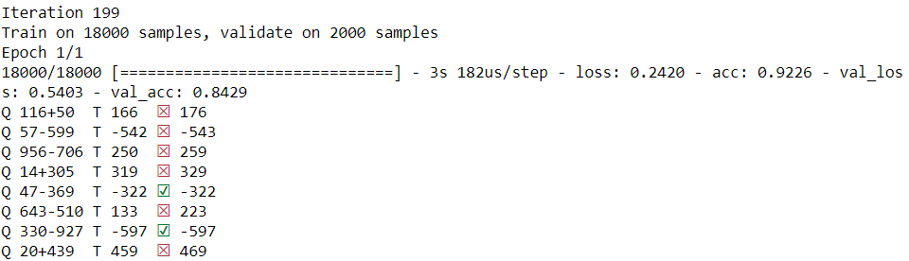
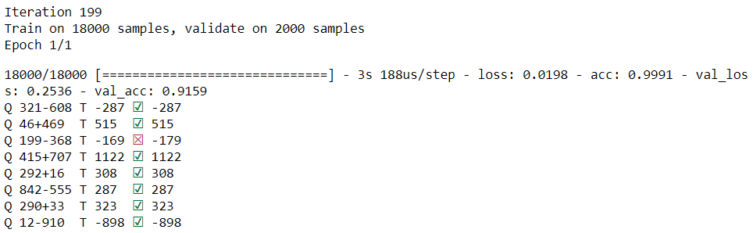
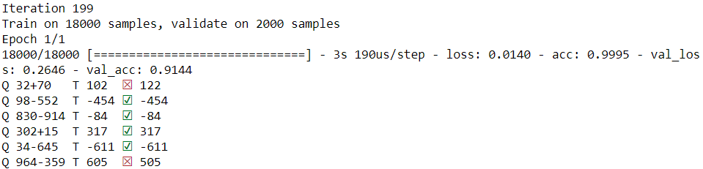
Training Size
Epoch200
Number10
Epoch200
Number100
Epoch200
Number200

